Slide 1
Writing GUI Programs
Section 3
Chapter 8
© 2016 Pearson Education, Ltd. All rights reserved.

Slide 2
GUI Programs
Normally written in object-oriented style
In this chapter we will
  Simplify the coding as much as possible
  Use a direct coding style
Every program from preceding chapters can be written as a GUI program
  But not conversely
  For instance, a GUI program using a list box with a scroll bar tied to it and containing a long list usually cannot be converted to a TUI program.
© 2016 Pearson Education, Ltd. All rights reserved.

Slide 3
Converting TUI Programs to GUI Programs
Programs consist of three components –
  Input, processing, and output
In TUI programs
  Input obtained from an input statement or from a file
  Output generated with a print statement or sent to a file
© 2016 Pearson Education, Ltd. All rights reserved.

Slide 4
Converting TUI Programs to GUI Programs
To convert TUI to GUI
  Input and print statements replaced with Label/Entry pairs
Processing data, inputting and outputting data to files
  Much the same in both types of programs
Primary difference
  processing in GUI programs usually triggered by an event
© 2016 Pearson Education, Ltd. All rights reserved.

Slide 5
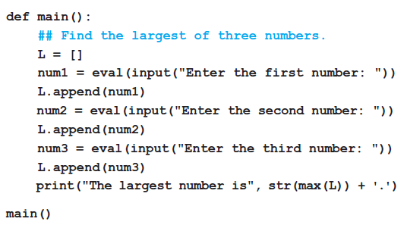
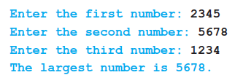
Converting TUI Programs to GUI Programs
FIGURE 8.31 A TUI program and a possible output
© 2016 Pearson Education, Ltd. All rights reserved.

Slide 6
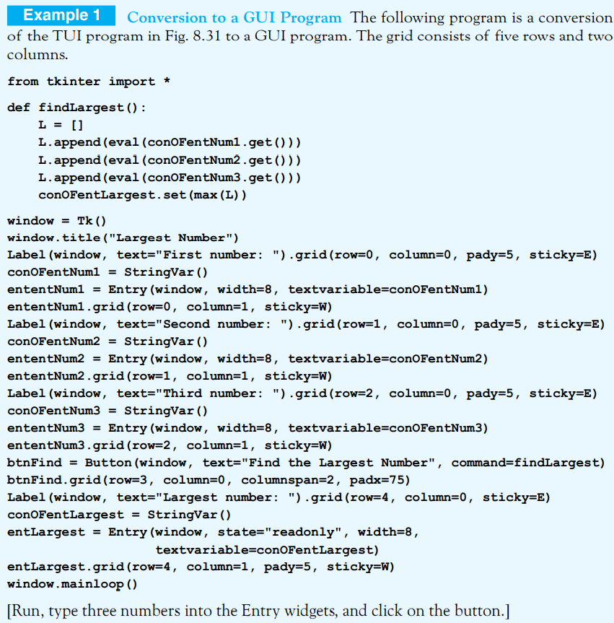
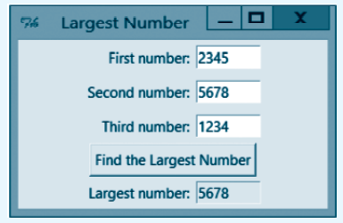

Slide 7
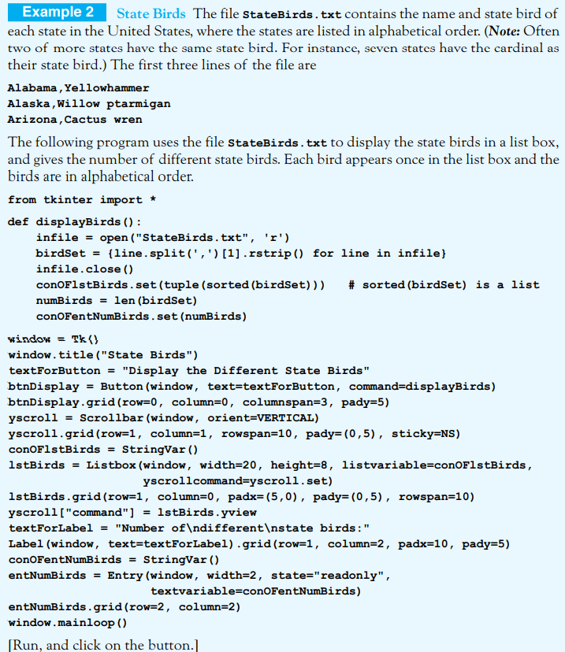
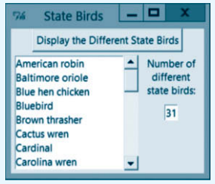
Filling List Boxes from a File:
List boxes tied to scroll bars are extremely useful in GUI programming. List boxes containing long lists are usually filled from files. The uses set comprehension to fill a list box in order to avoid the duplication of items in the list box.

Slide 8
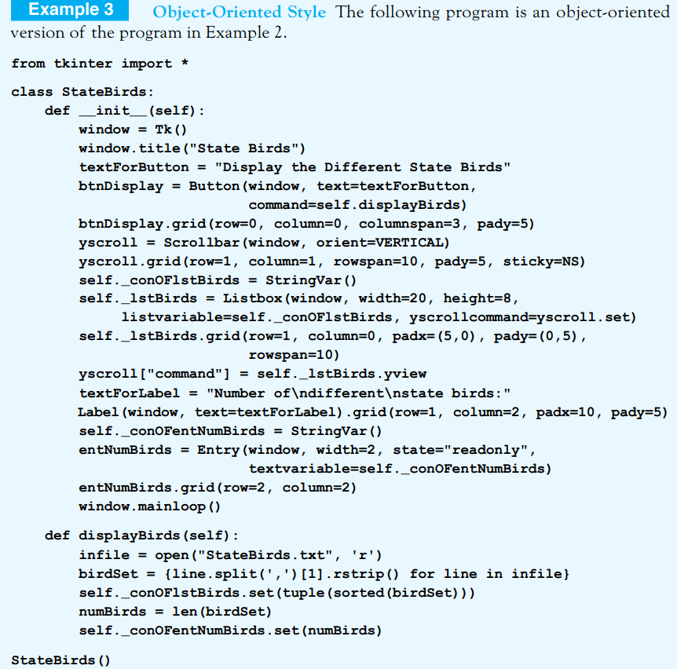

Slide 9
End
Section 3
Chapter 8
© 2016 Pearson Education, Ltd. All rights reserved.

